Slide 1
CS 470 Project Two Conference Presentation: Cloud Development
Christopher Abbott
June/2023

Slide 2
Overview
My name is Chris Abbott, and I am pursuing my bachelor’s in Computer Science
This presentation talks about moving a full stack application to the cloud.

Slide 3
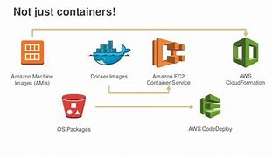
Containerization
The models used to migrate a full stack application to the cloud is a process done with AWS
The tools necessary for containerization are Docker and AWS.

Slide 4
Orchestration
The value of using Docker Compose is that it is fast and simple. It has a single host deployment, meaning you can run everything on a single piece of hardware. Docker compose has all containers isolated from each other which reduces threat.

Slide 5
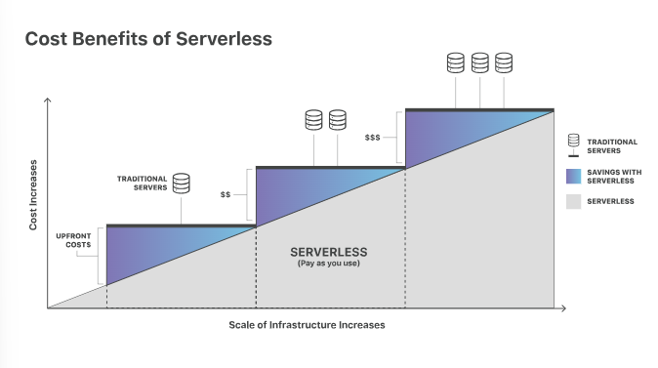
The Serverless Cloud
Serverless
Serverless is a method where users can write and deploy code without the hassle of worrying about underlying infrastructure.
Physical servers are still used, they just don’t have to be monitored.
As seen in the diagram, serverless is cost effective.
The advantages of using S3 storage is it has high scalability, high availability, and is highly secure.
Local storage is limited to what it can hold so the cost will end up being higher

Slide 6
The Serverless Cloud
API & Lambda
The advantages of using a serverless API are that it makes things more secure because the data isn’t just sitting in one place. Serverless does not have the permanent infrastructure.
When we created the APIs using Lambda, we were able to generate the functions. The methods we used were GET, PUT, POST, and DELETE
The steps needed to integrate the frontend with the backend are creating the database and transfer everything together.

Slide 7
The Serverless Cloud
Database
There are many data-model differences between MongoDB and DynamoDB
MongoDB is a document-oriented Database model. It is a popular database.
MongoDB is not based on the cloud, and DynamoDB is based on the cloud.
DynamoDB doesn’t have server-side scripts, MongoDB does have server-side scripts

Slide 8
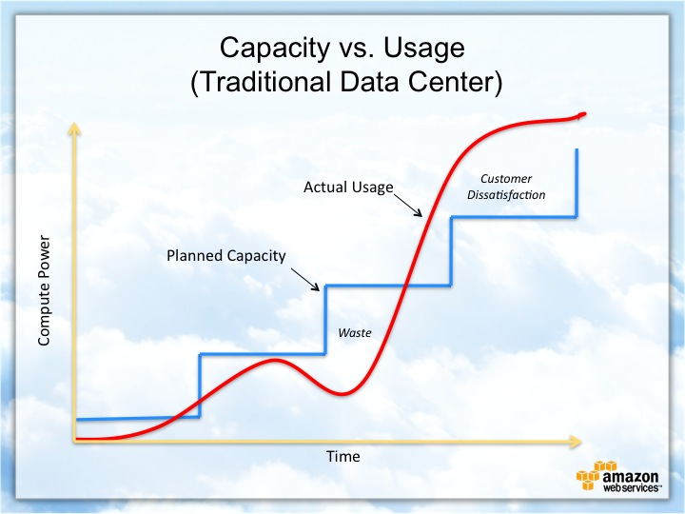
Cloud-Based Development Principles
Elasticity is the ability to increase or decrease the resources the application uses. Allows for better and easier scaling.
Pay-for-use model is a billing method that just charges customers for what they use and not a flat rate.

Slide 9
Securing Your Cloud App
Access
Policies
API Security
To prevent unauthorized access and secure your cloud app, you could start with encrypting sensitive data backed up to cloud storage providers.
Verifying that all machines do not have open RDP ports helps make things secure.
The relationship between roles and policies is that a role is something that has been authorized and defined, a policy is something that defines permissions of something
You secure the connection between Lambda and Gateway by using Cognito authorization token and securing the endpoints using either IAM roles or an API key.
Lambda and the database
S3 Bucket

Slide 10
Conclusion
Serverless is an ideal cloud-native development model that lets developers manage the applications better.
Prominent cloud service providers include Amazon web services, Microsoft Azure, and Google Cloud Platform.
Cloud-native development is a system of dividing the software applications into smaller services that can be used wherever you need.
Thank you for your time.

